Slide 1
Mythology
FROM A RUSSIAN PERSPECTIVE

Slide 2
ENGLAND
INUIT
PHILLIPINES
GREECE
FRANCE
IROQUOIS

Slide 3
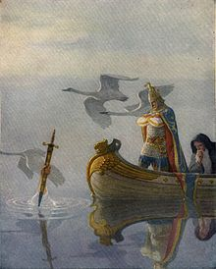
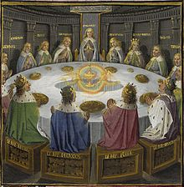
King Arthur Of ENGLAND
ENGLAND
Excalibur
Knights of the Round Table

Slide 4
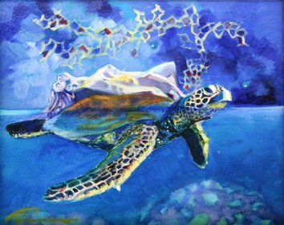
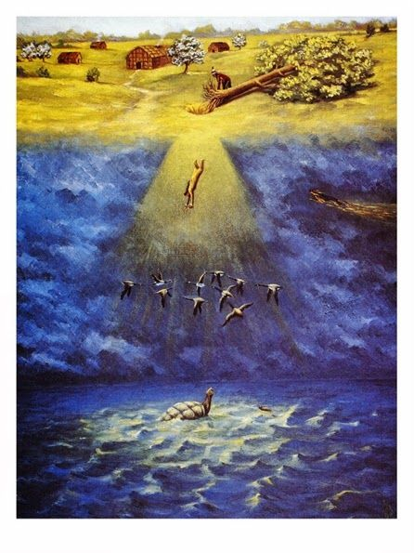
The Sky Woman Of Turtle Island
IROQUOIS
THE CREATION OF LAND
THE BRINGING OF LIFE

Slide 5
Russian Mythology in World Politics
Result of Russian Mythology on The Russian Population
Russian Mythology in the Post-Soviet Era

Slide 6
Operation Infektion
OPERATION INFEKTION:
Initiated in 1985
Paper written in 1986
Taken in by American News in 1989
Admission of Misinformation from the director of the KGB, Yevgeny Primakov, in 1992

Slide 7
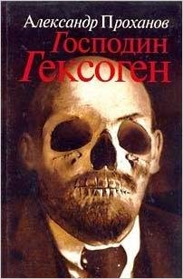
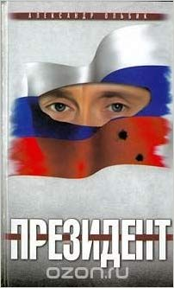
Putin in Russian Fiction
“Mr. Hexogen” (2001), Alexander Prokhanov, 1938
Depiction of Putin replacing Boris Yeltsin as President of the Russian Federation
Refers to Putin as “Izbrannik”, or “The Chosen One”
“The President” (2002), Aleksandr Ol’Bik
Putin resolving armed conflict in Chechnya
https://www.amazon.com/Gospodin-Geksogen-Aleksandr-Prokhanov/dp/5933210358
https://www.amazon.co.uk/Prezident-Aleksandr-Ol-Bik/dp/B01CVVLZVS

Slide 8
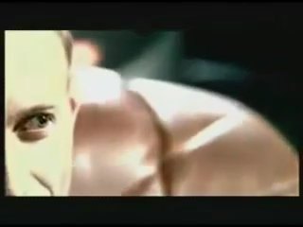

Slide 9
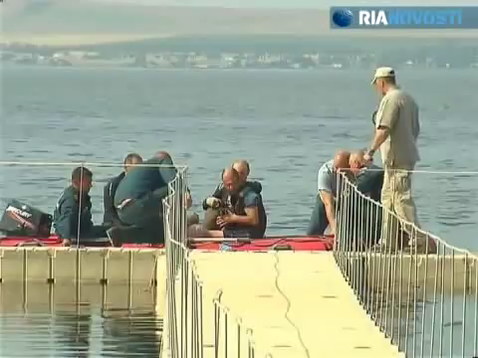

Slide 10
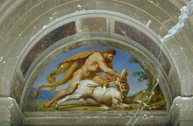
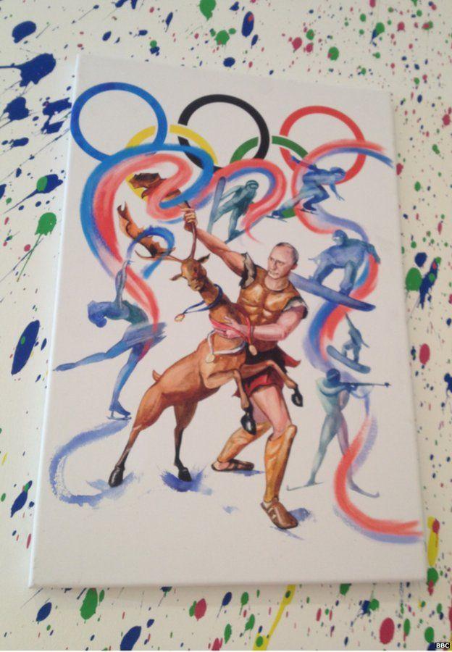
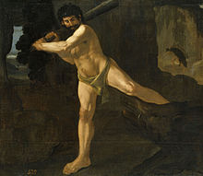
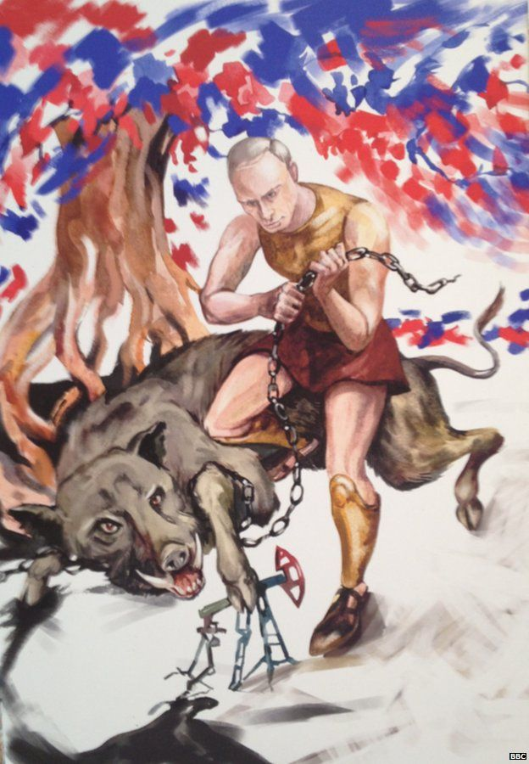
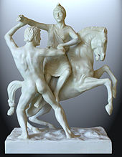
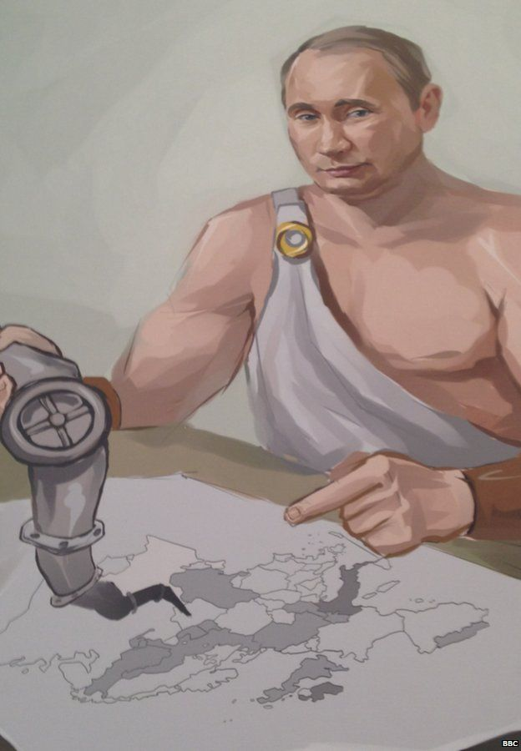
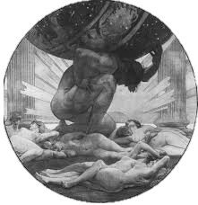
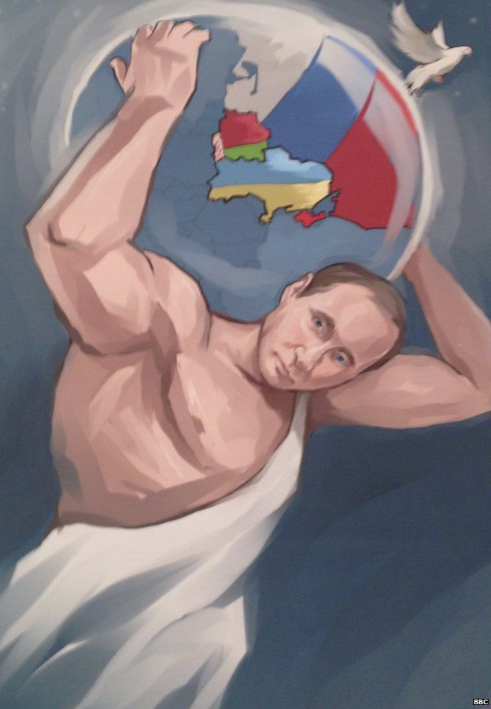
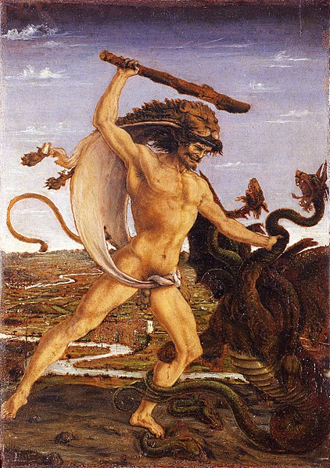
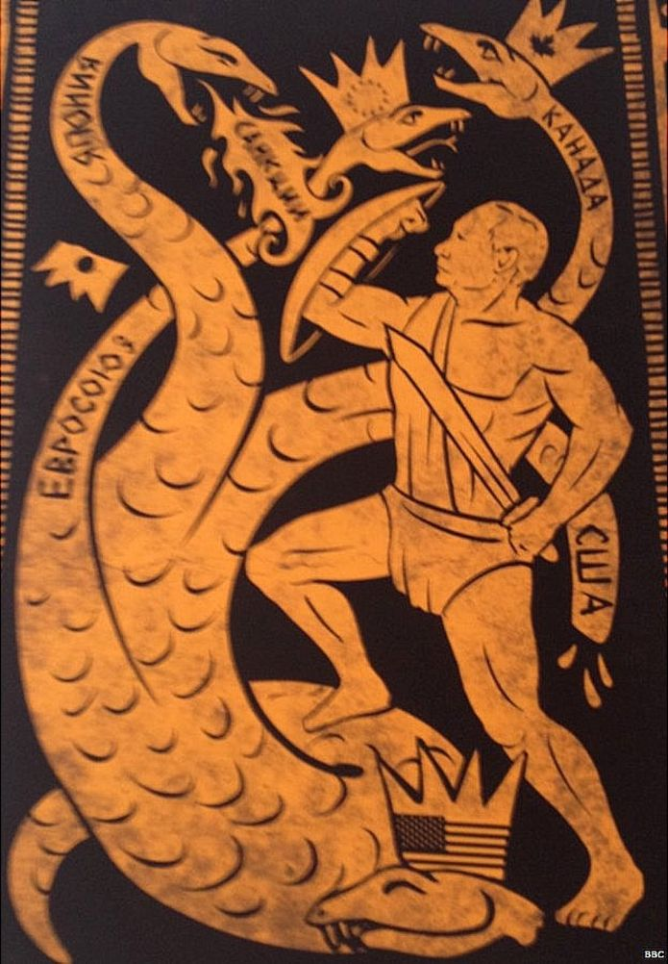
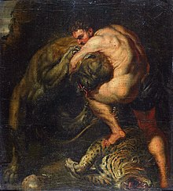
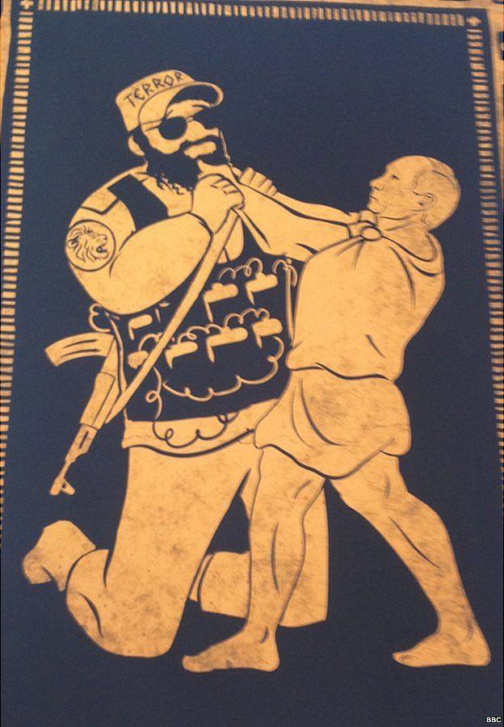
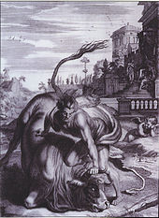
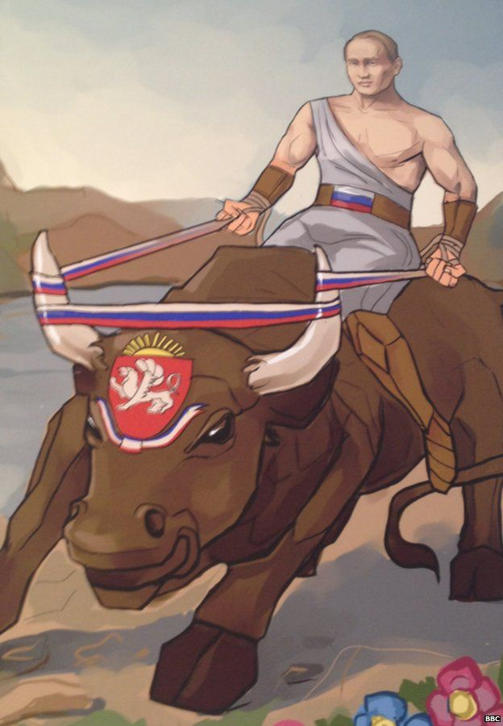
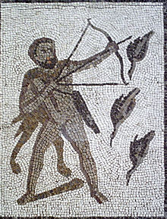
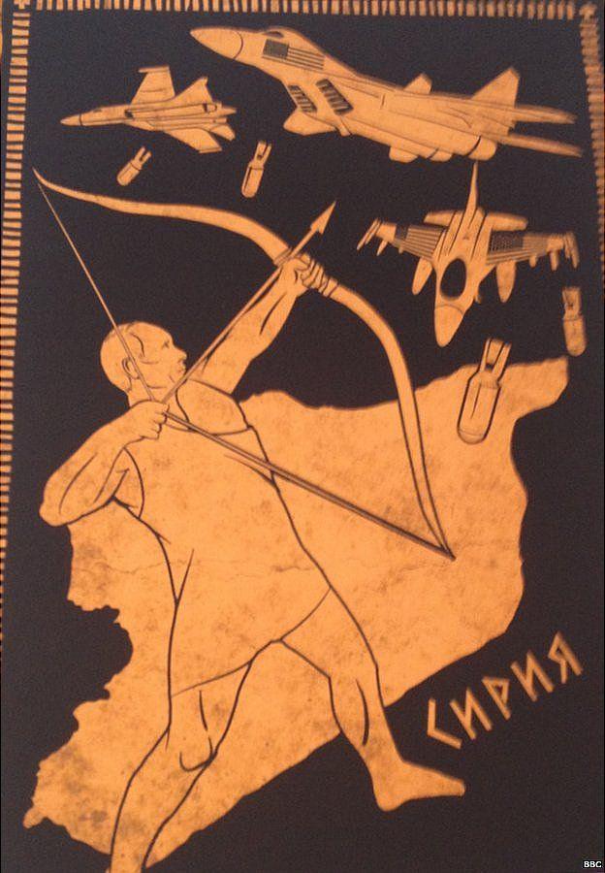
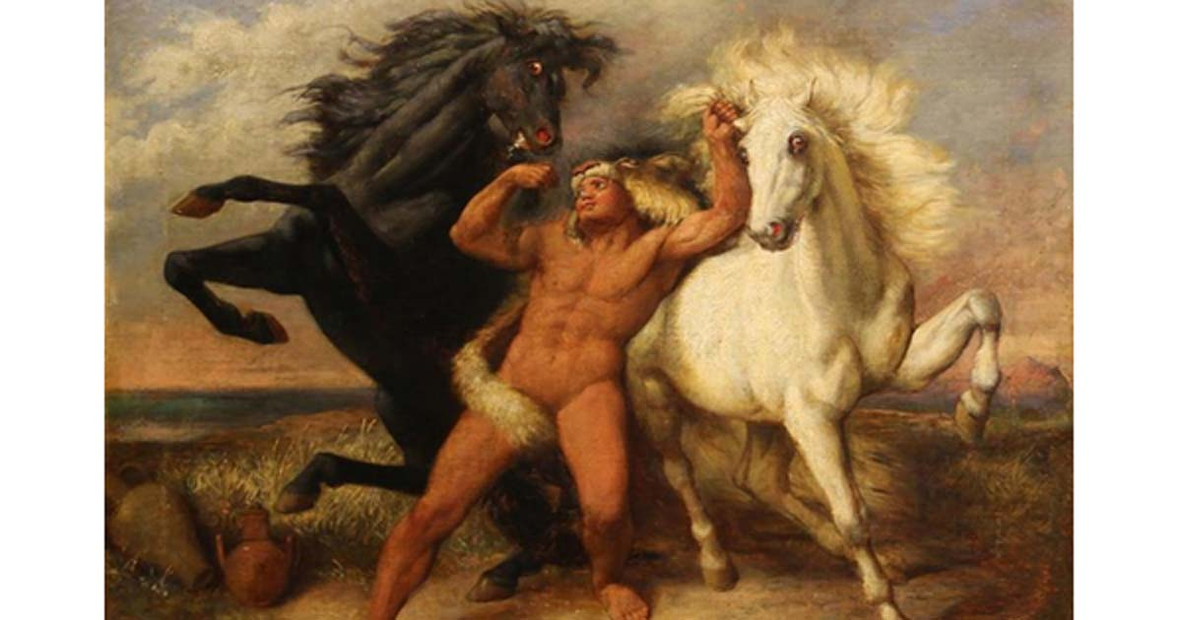
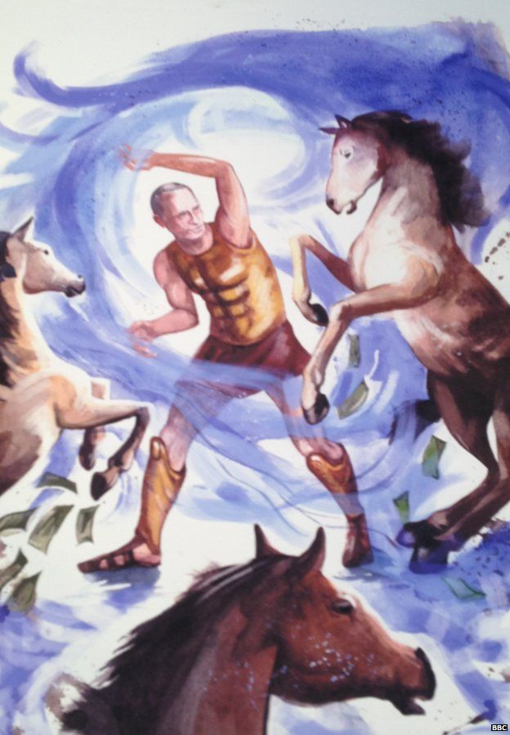
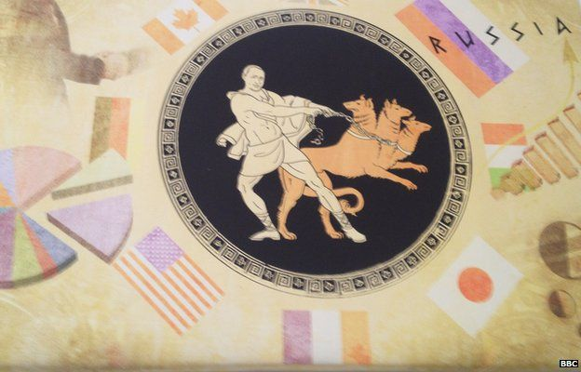
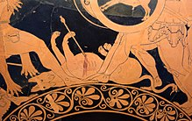
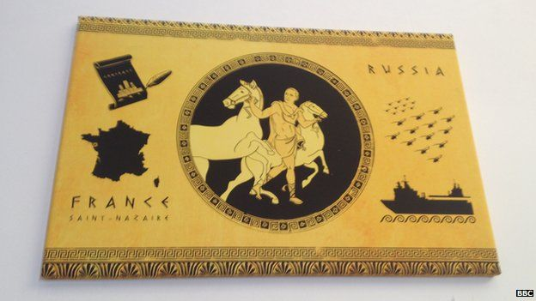
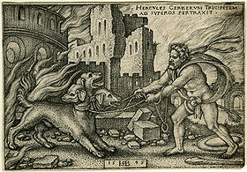
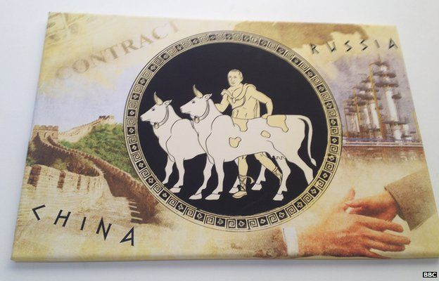
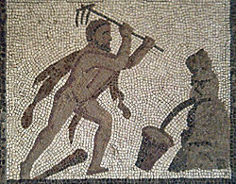
CAPTURING OF THE CERYNEIAN HIND
Herculean Original
Painting by Anonymous Organization

Slide 11
CAPTURE OF THE ERYMANTHIAN BOAR
Herculean Original
Painting by Anonymous Organization

Slide 12
OBTAINING THE GIRDLE OF HIPPOLYTA
Herculean Original
Painting by Anonymous Organization

Slide 13
STEALING THE APPLES OF THE HESPERIDES
Herculean Original
Painting by Anonymous Organization

Slide 14
SLAYING OF THE NINE HEADED LERNAEAN HYDRA
Herculean Original
Painting by Anonymous Organization

Slide 15
SLAYING THE NEMEAN LION
Painting by Anonymous Organization
Herculean Original

Slide 16
CAPTURE THE CRETAN BULL
Painting by Anonymous Organization
Herculean Original

Slide 17
SLAYING OF THE STYPHALIAN BIRDS
Herculean Original
Painting by Anonymous Organization

Slide 18
STEAL THE MARES OF DIOMEDES
Painting by Anonymous Organization
Herculean Original

Slide 19
CAPTURING CERBERUS
Herculean Original
Painting by Anonymous Organization

Slide 20
CATTLE OF GERYON
Painting by Anonymous Organization
Herculean Original

Slide 21
CLEANING THE STABLES
Herculean Original
Painting by Anonymous Organization

